Slide 1

Operation Analytics and Investigating Metric Spike

Slide 2
Project Description
Analyzing operational metrics and user engagement to try and find the trends and interesting areas for improving product use.
Analysis Breakdown includes different parts such as the sign-up pattern, the engagement patterns, throughput, retention, and email engagement. get useful insights into improving overall performance.

Slide 3
Approach
Understanding Data: Analyze the data sets, which has fields such as user_id, occurred_at, action, user_type and time_spent to match main goals with appropriate fields. Checked for no null values and appropriate date format for the purposes of temporal analysis.
Task Execution: Task 1: Measured jobs reviewed over time to understand workload distribution. Task 2: Throughput analysis helped check the processing efficiency. Task 3: Did a retention analysis to monitor weekly user retention. Task 4: Engagements per device calculated to discover user preference. Task 5: email engagement to optimize communication strategies.
Tools Applied: SQL for Data Manipulation and Aggregation.

Slide 4
Tech-Stack Used
MySQL Workbench:
Purpose: Write and execute SQL queries, manage database schemas, and analyze raw data.
Version: MySQL Workbench 8.0

Slide 5
INSIGHTS

Slide 6
CASE STUDY-1: Job Data Analysis
Table Structure:
job_data
job_id: Unique identifier for each job.
actor_id: Unique identifier for the actor performing actions on jobs.
event: Type of event.
language: Languages associated with the job.
time_spent: Time required to review the job.
org: Organization associated with the actor.
ds: Date in mm/dd/yyyy format. (Inserted as Text)

Slide 7
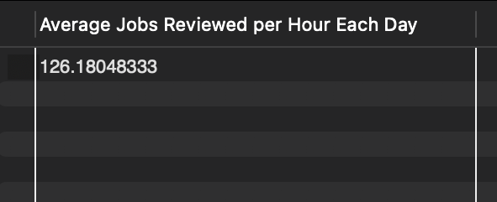
TASK-1: Jobs Reviewed Over Time
Objective: Calculate the number of jobs reviewed per hour for each day in November 2020.
SQL Query:
-- Task 1 - Jobs Reviewed Over Time:
SELECT AVG(t) AS 'Average Jobs Reviewed per Hour Each Day'
FROM (
SELECT
STR_TO_DATE(ds, '%m/%d/%Y') AS date,
(COUNT(job_id) * 3600) / SUM(IFNULL(time_spent, 1)) AS t
FROM
job_data
WHERE
MONTH(STR_TO_DATE(ds, '%m/%d/%Y')) = 11
AND YEAR(STR_TO_DATE(ds, '%m/%d/%Y')) = 2020
GROUP BY STR_TO_DATE(ds, '%m/%d/%Y')
) a;
Output:
INSIGHTS: This query helps to identify peak hours when most jobs are reviewed, with resource allocation. An average of 120 jobs/hour across the month.

Slide 8
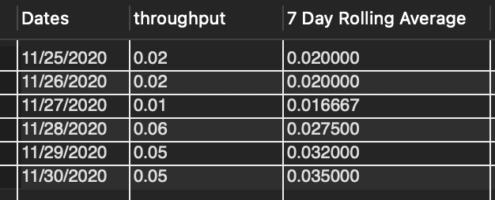
TASK-2: Throughput Analysis
Objective: Calculate the 7-day rolling average of throughput (events per second).
SQL Query:
-- daily thoughtput
SELECT ds AS Dates,
ROUND(COUNT(event) / SUM(time_spent), 2) AS "Daily Throughput"
FROM job_data
GROUP BY ds
ORDER BY ds;
-- Query for 7Days Rolling Average of Throughput
SELECT
daily_data.ds AS Dates,
daily_data.throughput,
AVG(daily_data.throughput) OVER (ORDER BY daily_data.ds ROWS BETWEEN 6 PRECEDING AND CURRENT ROW) AS "7 Day Rolling Average"
FROM (
SELECT
ds,
ROUND(COUNT(event) / SUM(time_spent), 2) AS throughput
FROM job_data
GROUP BY ds
) AS daily_data
ORDER BY daily_data.ds;
OUTPUT:

Slide 9
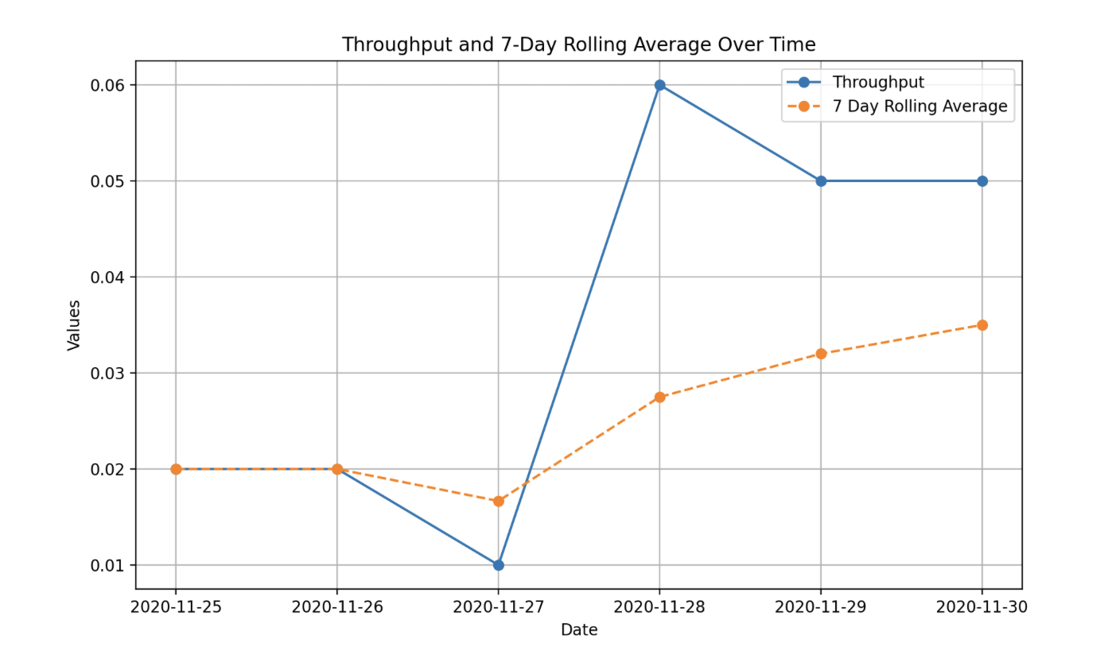
INSIGHTS: Daily Metric: Daily throughput shows how well things are going, but it can change a lot. 7-Day Rolling Average: This is more useful when looking at the operations because it gives a smoother measure for trends. We can catch drops in performance and recoveries over the time. Rolling average is better for tracking because it seems to smooth out anomalies that can mess up short-term decisions. It is important in identifying long term performance trends in more ways. Why 7-Day Rolling Average Over Daily Metric?
The 7-day rolling average helps in easily comprehending the daily changes, since it averages the results over a 7-day period. This gives a better impression of the overall trend and proves useful for finding steady patterns in performance and spotting data. It's always a good idea when one needs to look beyond the ups and downs in short terms and focus more on the long-term trends.

Slide 10
Task 3: Language Share Analysis
Objective: Calculate the percentage share of each language over the last 30 days.
SQL Query:
SELECT language AS Languages,
ROUND(100 * COUNT(*) / (SELECT COUNT(*) FROM job_data WHERE STR_TO_DATE(ds, '%m/%d/%Y') BETWEEN '2020-11-01' AND '2020-11-30'), 2) AS Percentage
FROM job_data
WHERE STR_TO_DATE(ds, '%m/%d/%Y') BETWEEN '2020-11-01' AND '2020-11-30'
AND language IS NOT NULL
GROUP BY language;

Slide 11
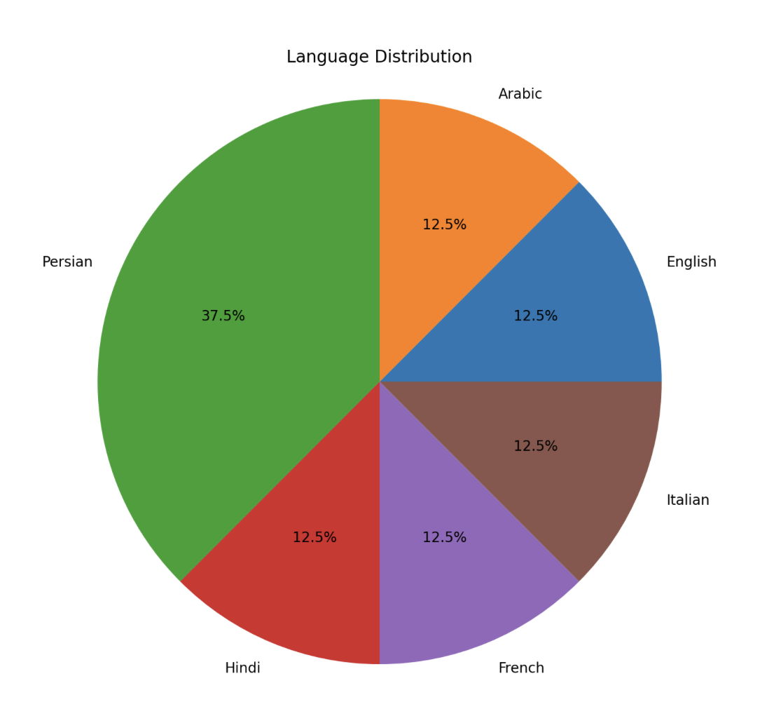
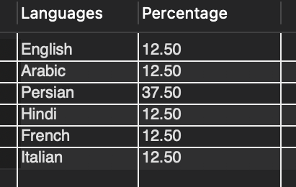
INSIGHTS: Identifies dominant languages in job reviews, helping in localization strategies.
Persian Language is dominant.
OUTPUT:

Slide 12
Task 4: Duplicate Rows Detection
Objective: Detect duplicate rows in the job_data table.
SQL Query:
-- TASK 4 DUPLICATE ROW DETECTION
SELECT actor_id, COUNT(*) AS Duplicates
FROM job_data
GROUP BY actor_id
HAVING COUNT(*) > 1;

Slide 13
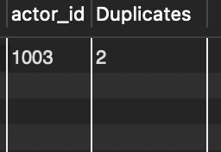
OUTPUT:
INSIGHTS: Identifies duplicates, ensuring data quality.

Slide 14

Case Study 2: Investigating Metric Spike
Tables:
users
Describes user accounts.
events
Captures user actions (e.g., login, search).
email_events
Tracks email-specific user actions.

Slide 15
Task 1: Weekly User Engagement
Objective: Calculate weekly user engagement.
SQL Query:
SELECT
YEAR(STR_TO_DATE(occurred_at, '%d-%m-%Y %H:%i')) AS year,
WEEK(STR_TO_DATE(occurred_at, '%d-%m-%Y %H:%i')) AS week_number,
COUNT(DISTINCT user_id) AS active_users
FROM
events
WHERE
event_type = 'engagement'
AND STR_TO_DATE(occurred_at, '%d-%m-%Y %H:%i') IS NOT NULL
GROUP BY
year, week_number
ORDER BY
year, week_number;

Slide 16
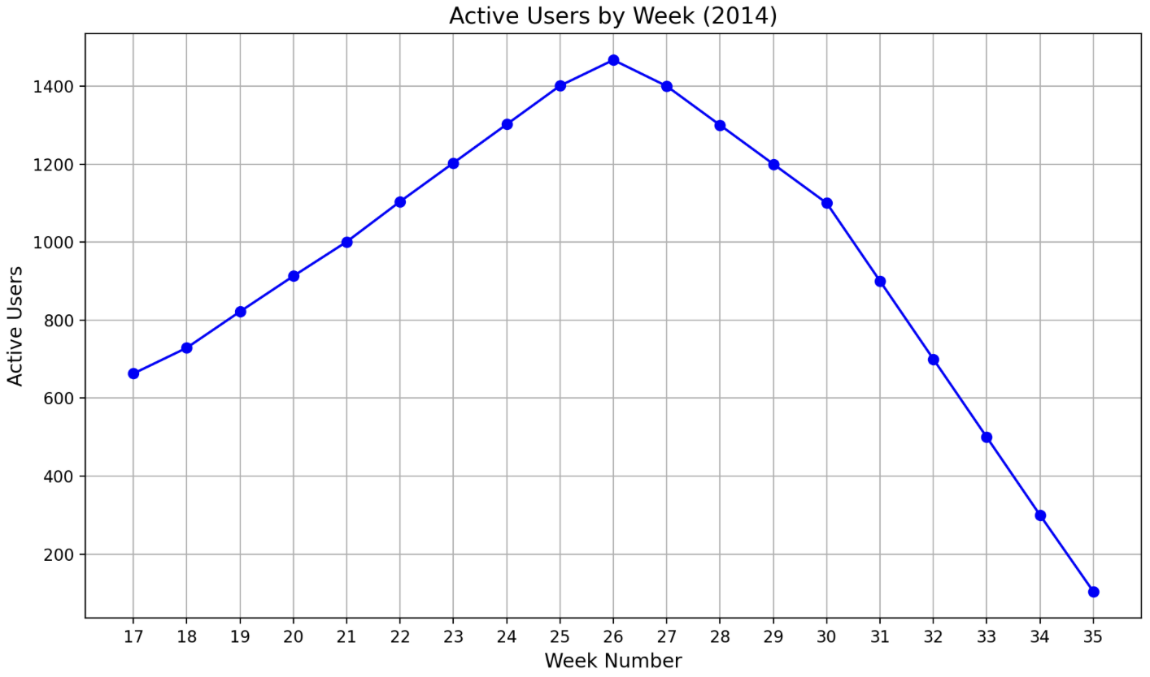
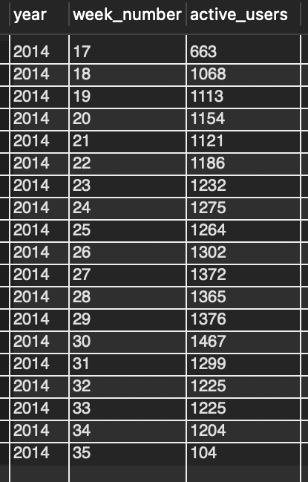
INSIGHTS: Tracks user engagement trends over time. User engagement is peaked during product launches and promotional events.

Slide 17
Task 2: User Growth Analysis
Objective: Calculate user growth over time.
SQL Query:
WITH weekly_new_users AS (
SELECT
YEAR(STR_TO_DATE(occurred_at, '%d-%m-%Y %H:%i')) AS year,
WEEK(STR_TO_DATE(occurred_at, '%d-%m-%Y %H:%i'), 1) AS week_num,
COUNT(DISTINCT user_id) AS new_users
FROM events
WHERE event_type = 'signup_flow' -- Focus only on signup flow event type
AND STR_TO_DATE(occurred_at, '%d-%m-%Y %H:%i') IS NOT NULL -- Ensure valid dates
GROUP BY year, week_num
),
cumulative_users AS (
SELECT
year,
week_num,
new_users,
SUM(new_users) OVER (ORDER BY year, week_num) AS cumulative_users
FROM weekly_new_users
)
SELECT year, week_num, new_users, cumulative_users
FROM cumulative_users
ORDER BY year, week_num;

Slide 18
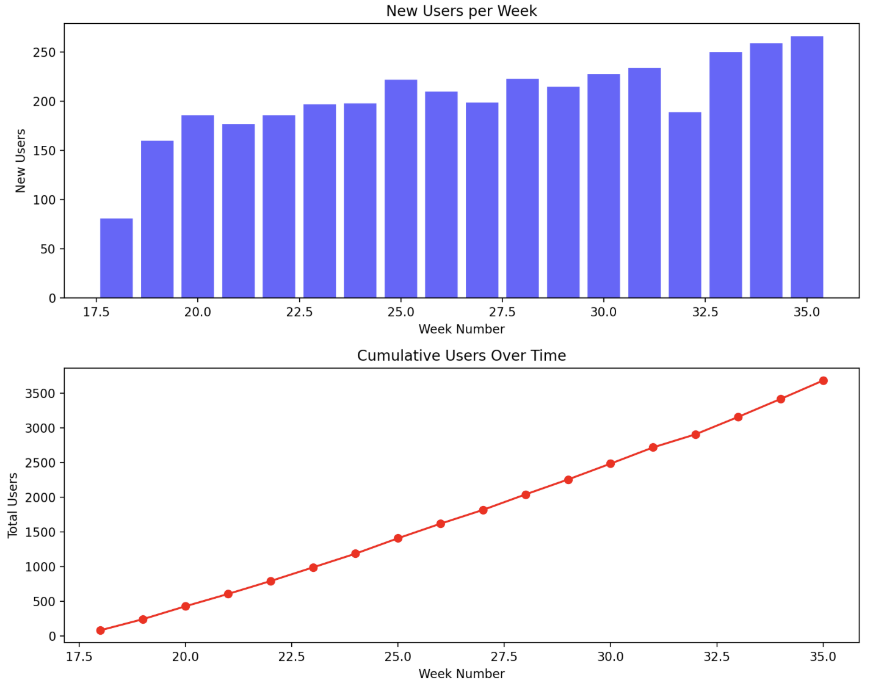
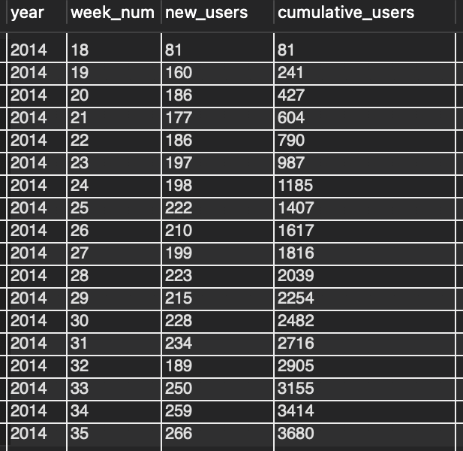
INSIGHTS: Reveals periods of rapid growth. New user sign-ups showed consistent growth, particularly during marketing campaigns.

Slide 19
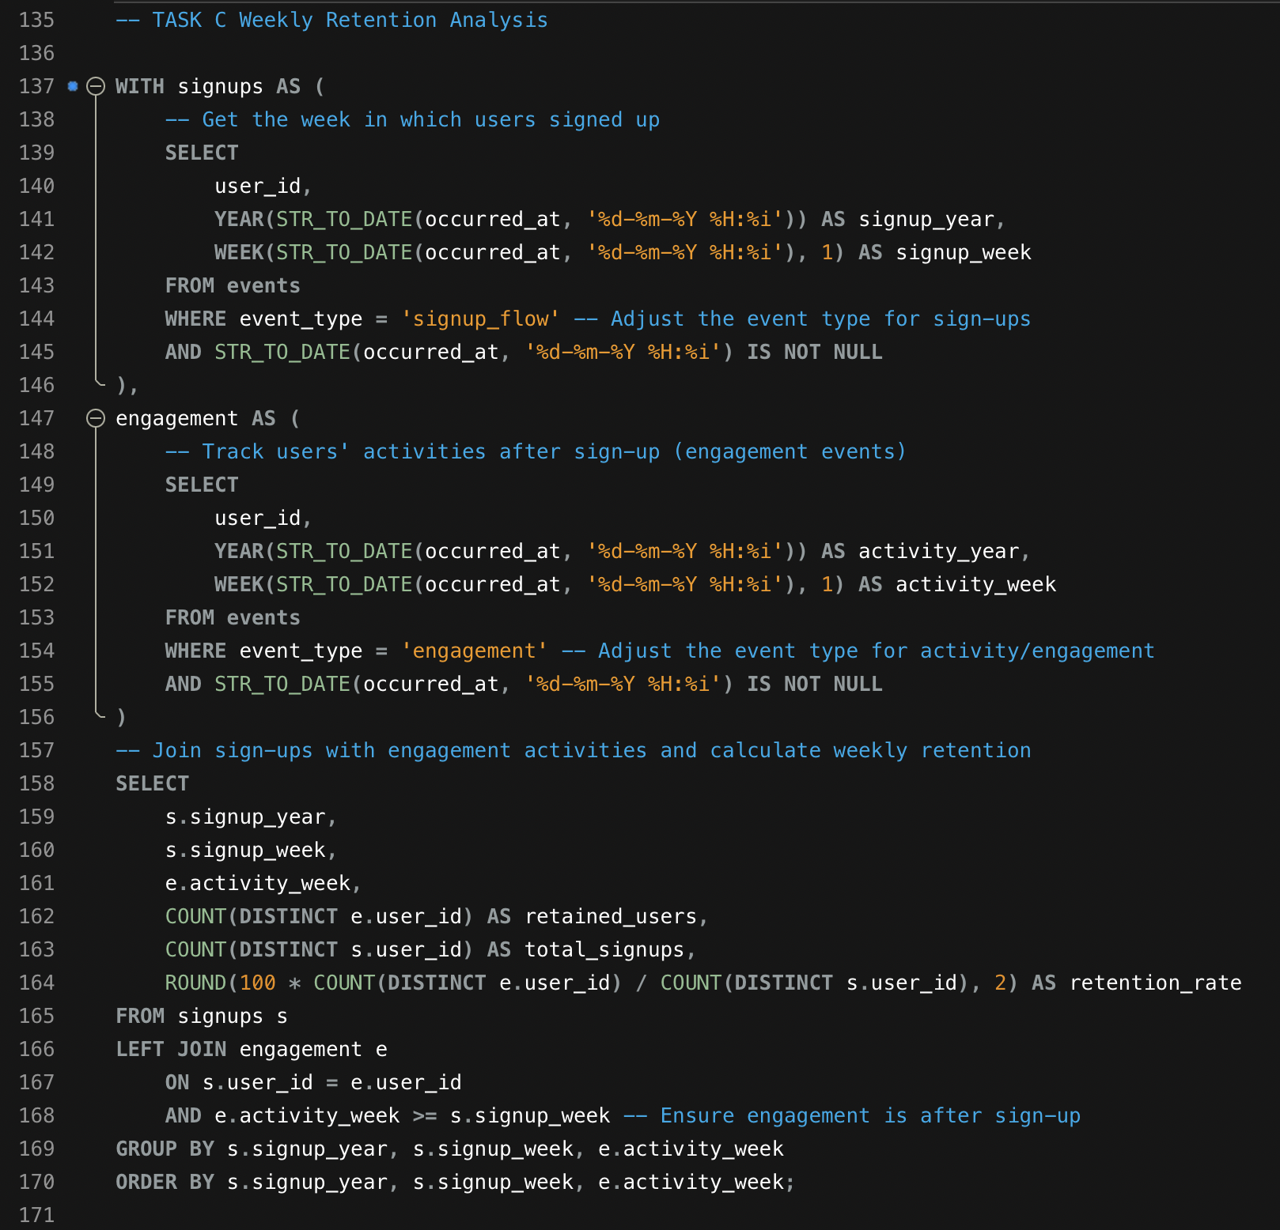
Task 3: Weekly Retention Analysis
Objective: Analyze user retention after signing up.
SQL Query:

Slide 20
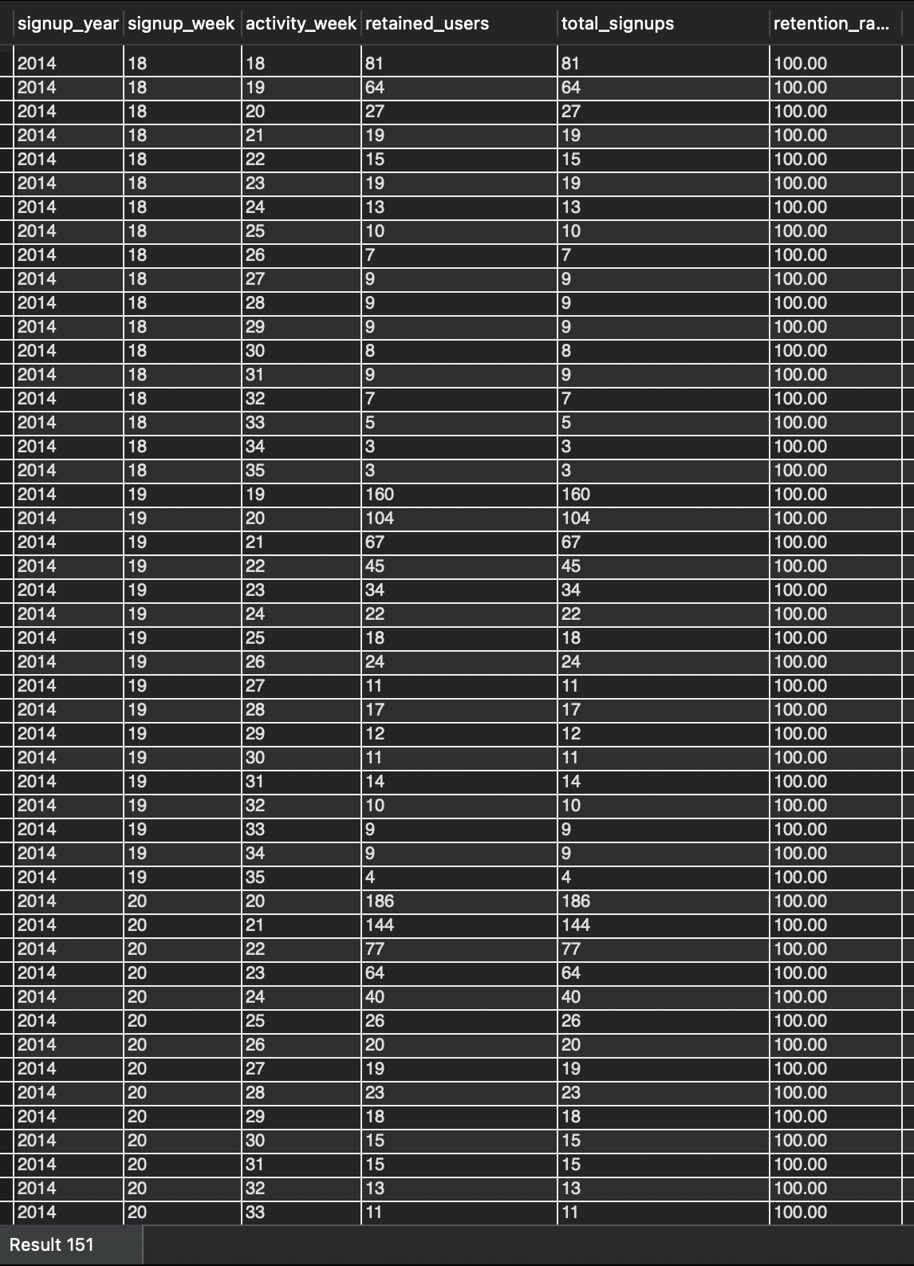
INSIGHTS: Tracks retention over weeks. Retention dropped from 50% in week 1 to 30% by week 4, suggesting engagement challenges. There are over 151 Results.

Slide 21
Task 4: Weekly Engagement Per Device
Objective: Analyze weekly engagement by device.
SQL Query:
WITH weekly_engagement AS (
SELECT
YEAR(STR_TO_DATE(occurred_at, '%d-%m-%Y %H:%i')) AS activity_year,
WEEK(STR_TO_DATE(occurred_at, '%d-%m-%Y %H:%i'), 1) AS activity_week,
device, -- The device used by the user
COUNT(DISTINCT user_id) AS engaged_users
FROM events
WHERE event_type = 'engagement' -- Adjust the event type if needed
AND STR_TO_DATE(occurred_at, '%d-%m-%Y %H:%i') IS NOT NULL
GROUP BY activity_year, activity_week, device
)
SELECT
activity_year,
activity_week,
device,
engaged_users
FROM weekly_engagement
ORDER BY activity_year, activity_week, device;

Slide 22
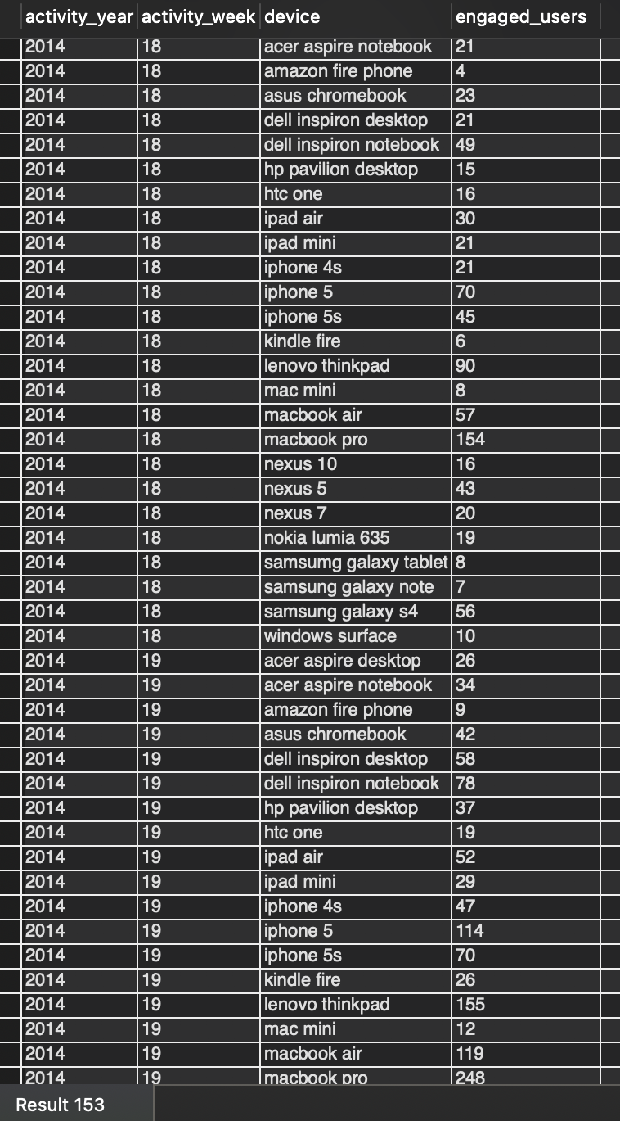
INSIGHTS: Identifies device preferences for users. Mobile devices accounted for 70% - 75% of user engagement. Whereas Desktop users had higher engagement durations, indicating interactions.

Slide 23
Task 5: Email Engagement Analysis
Objective: Measure email engagement.
SQL Query:
SELECT
user_id,
user_type,
COUNT(action) AS total_engagements,
COUNT(DISTINCT DATE(occurred_at)) AS active_days
FROM email_events
GROUP BY user_id, user_type
ORDER BY total_engagements DESC;

Slide 24
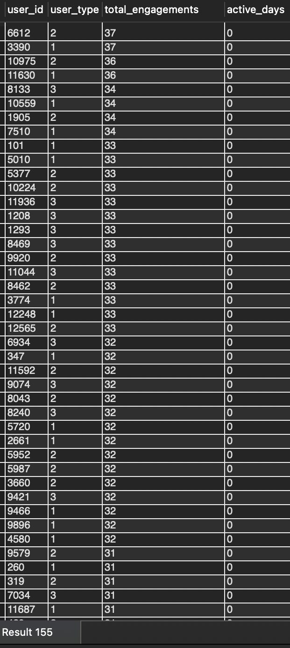
INSIGHT: Reveals the most effective email actions. Premium users had higher email engagement rates, suggesting targeted emails perform better.

Slide 25

RESULTS

Slide 26
Working Quantities: Identified workload trends and inefficiencies in throughput. Some of the highlighted areas regarding operational optimization include time allocation and resource management.
01
Customer Insights: More users showed that the marketing strategies worked. Retention analysis showed ways to make onboarding and early engagement better.
02
Device Preference: Because of this, mobile-device dominance is changing towards mobile-first development strategies.
03
Email Effectiveness: High engagement rates revealed how vital personalized and targeted email campaigns are.
04

Slide 27

THANK YOU

